Slide 1
WHAT TO EAT
ORDERING MADE EASY
Members: Emilie Gao, Albert Phone,
Justin Jeong, Mike Wang, Christine lee

Slide 2


The Issue:
“What’s your most popular menu item?”
Many of us go to restaurants and ask the waiter for recommendations, only to find more difficulty in deciding on a dish than before

Slide 3
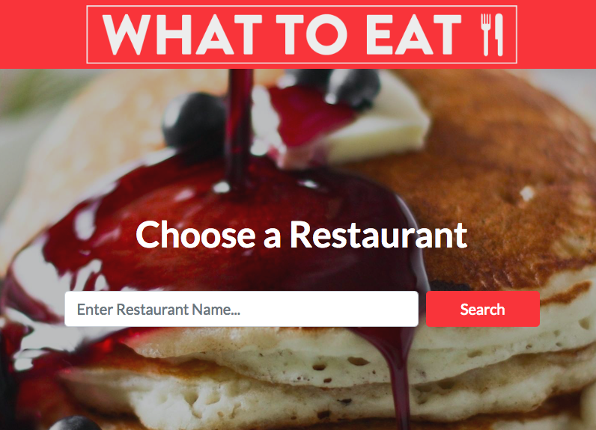
Our Solution: What to Eat
What To Eat will find the restaurant’s most commonly ordered items and find the respective ratings using NLP sentiment analysis.

Slide 4

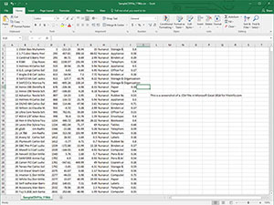

Architecture of Project
Data Organization
Back end/Front end
Application Host
Collected data in a CSV file that was later called and parsed through by our algorithm in python
Used python, HTML, CSS, and JavaScript to create our application
Hosted our application on a local web host

Slide 5
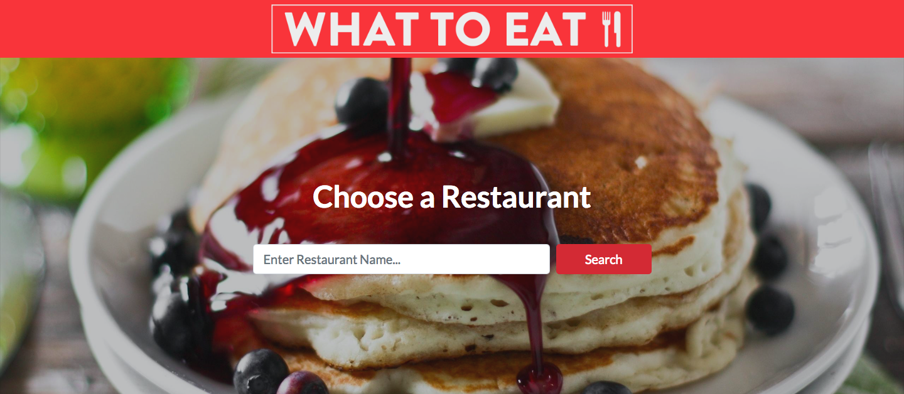
Project Approach
“What should I eat?”
For the past couple of weeks, our team has met regularly to create an application to solve our dilemma of deciding what to eat at restaurants
Collect Data
Gather the necessary data to parse through and make our application work
Create the Algorithm
Create an algorithm using sentimental analysis to evaluate reviews
Create User Interface
Create an easy, enjoyable application experience for users
Present App
Present project to IEOR 135 class and receive feedback

Slide 6



Data Collection: Our Approach
Data Collecting
Web Scraping
Data Organization
Spent months collecting and researching menu items for specific restaurants
Gathering data through web-scraping techniques such as HTML parsing
Cleaned data to produce a CSV file that can be parsed and analyzed with our function

Slide 7



Creating the Algorithm
Cleaning and Lemmatizing Reviews
Generating unique hit words and pair matching
Sentiment Analysis
1.
2.
3.
Preprocessed words for better hit results
Unique hit words allow us to recognize specific menu items being referenced in a review
Analyzed sentiment value for specific sentences and properly scaled it

Slide 8
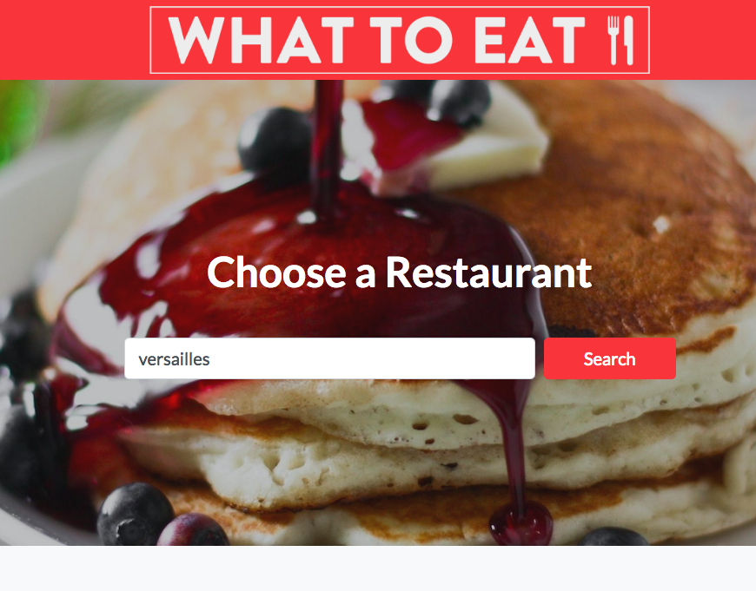
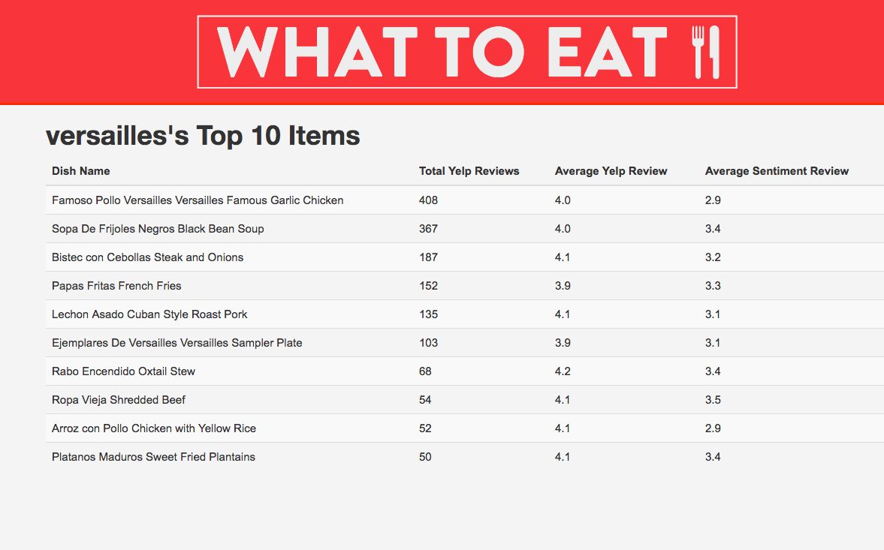
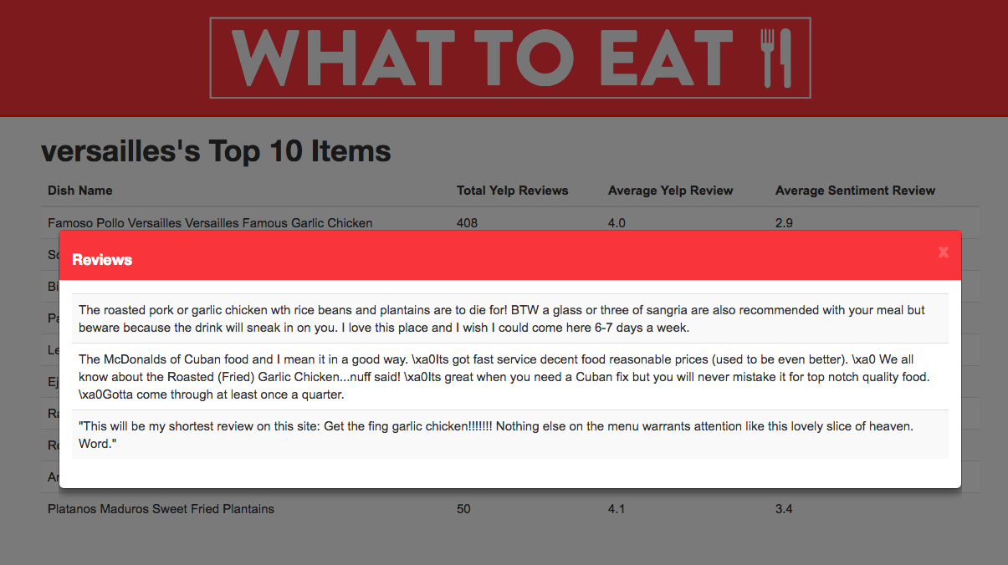
Creating the Application/User Interface
We wanted to make our application to be simple and easily used by anybody.
1.
2.
3.
Type in the restaurant of where you are planning to eat
The restaurant’s top 10 menu items will be outputted
Click on the item you are interested to see up to see some reviews associated with that menu item

Slide 9
What we expected
What we learned
Data collection was challenging and tedious and took the majority of the time when working on the project
Include user-uploaded photos, menu items, and reviews for each restaurant
Expected actual algorithm and implementation of NLP to be the most challenging part of the problem
Our algorithm doesn’t work as effectively when working with restaurants with poorly documented menu items but works well otherwise
Create a web app with an interactive user-friendly interface
We learned a lot about web development as none of us had any previous experience

Slide 10
Demo

Slide 11
Questions?

Slide 12
Moving Forward with What to Eat
Add photos to reviews
Improve user experience by adding photos to menu items
Present App to Yelp
Pitch our project to Yelp to hopefully land an internship
Collect Data
Collect more relevant data and improve menu documentation quality
Put App on Heroku
Present project to IEOR 135 class and receive feedback

Slide 13
References
Gong, A., & Lu, J. (n.d.). Picking Out Good Dishes from Yelp. Retrieved from https://nlp.stanford.edu/courses/cs224n/2015/reports/4.pdf
W. (n.d.). How TO - Search Bar. Retrieved April 29, 2018, from https://www.w3schools.com/howto/howto_css_searchbar.asp
TextBlob: Simplified Text Processing¶. (n.d.). Retrieved April 29, 2018, from http://textblob.readthedocs.io/en/dev/

Slide 14
https://github.com/albyphoney/whattoeat

